Slide 1
Java Object Persistence
3.4 Design Constraints

Slide 2
The viable options:
Native Serialization
GSON
XStream

Slide 3
Native Serialization
It’s a very brittle method to persist objects.
Not necessarily easy to debug as it requires us to write code to read anything that we have actually saved to files. We wouldn’t be able to just open the file and change values in order to test or debug.
An object’s serialized form is tied to its class, meaning that if we change a class half way through, the serialized instance of the old class cannot be loaded into the new class. We can combat this by setting a serialVersionID, but then we cannot read older classes into the new.
Tends to be much slower and it often expands the size of the object.

Slide 4
GSON
Provides simple toJson() and fromJson() methods to convert Java objects to JSON and vice-versa.
Allows for custom representations for objects.
Not the easiest to read unless we beautify the JSON, which still isn’t necessarily the nicest to read for testing and debugging purposes.

Slide 5
XStream
Allows us to quickly and simply convert a Java Object to XML and vice-versa
Deals with new classes and old classes much better than Native Serialization
Allows us to give classes specific aliases that will be used when the XML is generated
Much easier to read and debug
Relatively quick, so would be ideal for automatically saving the game status and data

Slide 6
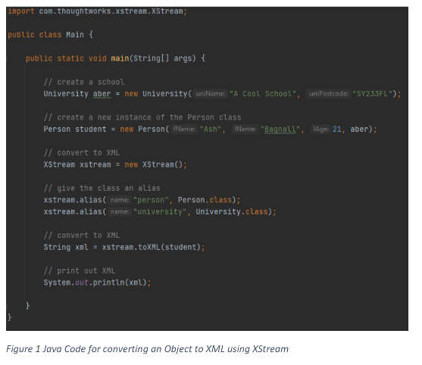
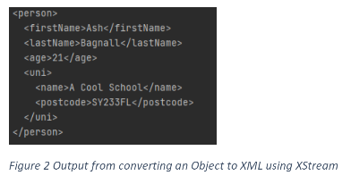
Using XStream

